Slide 1
Applications of Machine Learning in Healthcare
Madaser Saleem

Slide 2
Top Ten Health Problems in America
Cardiovascular Disease
Cancer
Stroke
Respiratory Disease (COPD, CF)
Diabetes
Alzheimer's
Influenza/Pneumonia
Kidney Disease
Septicemia

Slide 3
Breast Cancer
Worldwide, breast cancer is the most frequently diagnosed life-threatening cancer in women and the leading cause of cancer death among women.
Breast cancer is often first detected as an abnormality on a mammogram before it is felt by the patient or health care provider.
Evaluation of breast cancer includes the following:
Clinical examination
Imaging
Needle biopsy

Slide 4
Definitions
Sensitivity measures how often a test correctly generates a positive result for people who have the condition that’s being tested for . A test that’s highly sensitive will flag almost everyone who has the disease and not generate many false-negative results.
Specificity measures a test’s ability to correctly generate a negative result for people who don’t have the condition that’s being tested for. A high-specificity test will correctly rule out almost everyone who doesn’t have the disease and won’t generate many false-positive results.
PPV is used to indicate the probability that in case of a positive test, that the patient really has the specified disease.

Slide 5
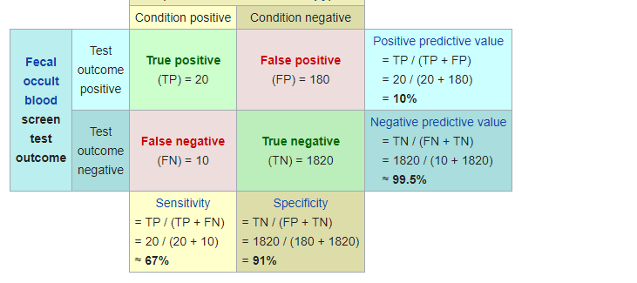
Biostatistics
Mammography sensitivity range from 75% to 90% with specificity from 90% to 95%.
Positive predictive value of mammography for breast cancer ranges from 20% in women under age 50 to 60% to 80% in women age 50-69.

Slide 6
Breast Cancer Wisconsin (Diagnostic) Data Set
Features are computed from a digitized image of a fine needle aspirate (FNA) of a breast mass.
This dataset contains 32 attributes (columns) based on ten unique features of the breast mass.

Slide 7
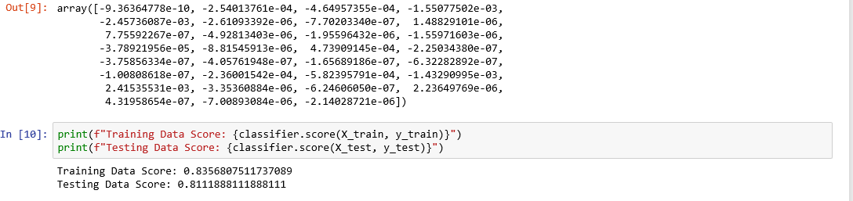
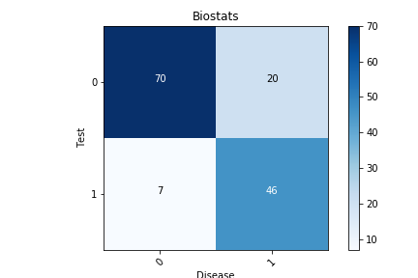
Logistic Regression

Slide 8

Logistic Regression Cont’d

Slide 9
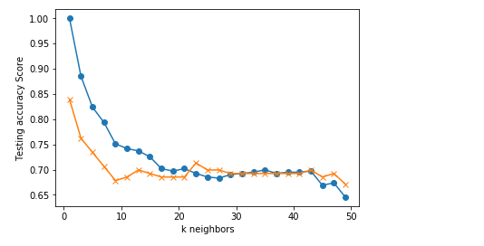
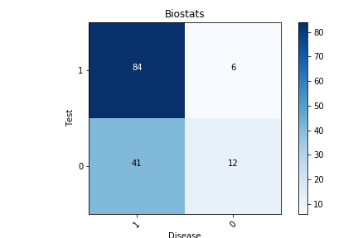


KNN

Slide 10
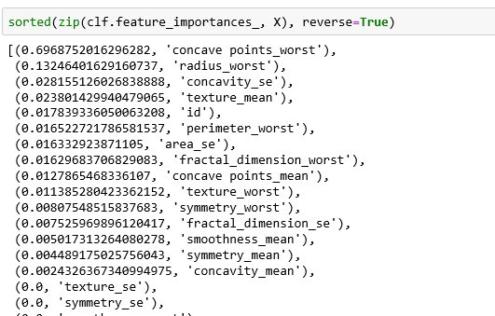
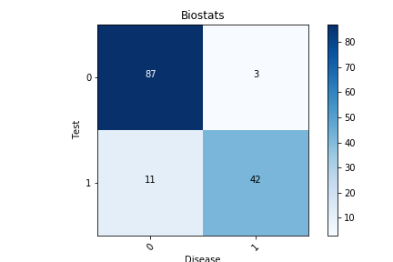
Decision Tree

Slide 11
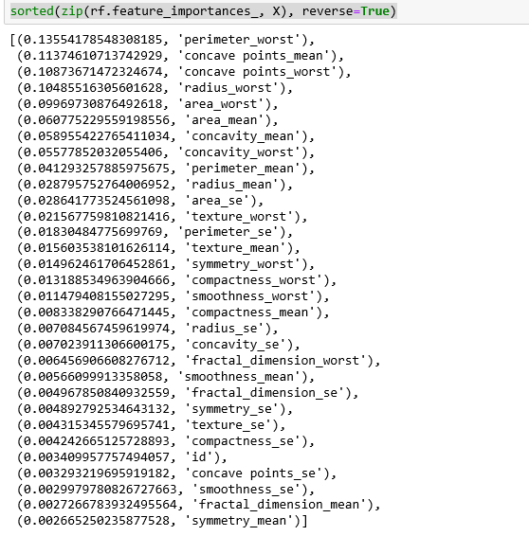
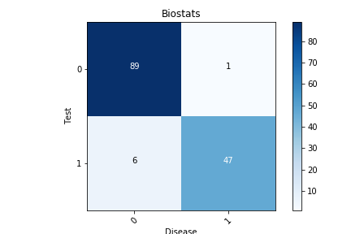

Random Forest

Slide 12
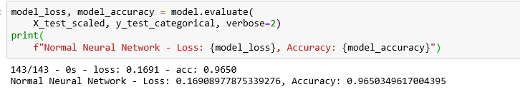
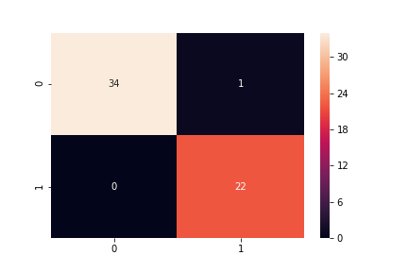
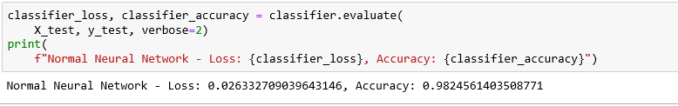

Tensor Flow (Neural Network)

Slide 13
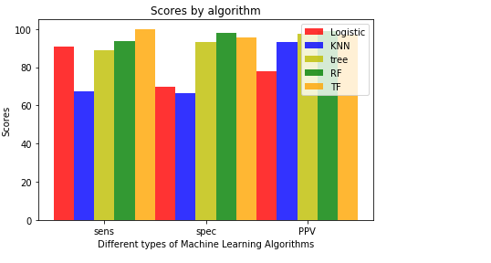
Comparisons

Slide 14
Machine Learning in HealthCare
Machine learning plays a key role in many health-related realms, including the development of new medical procedures, the handling of patient data and records and the treatment of chronic diseases.
Examples include:
KenSci uses machine learning to predict illness and treatment to help physicians and payers intervene earlier, predict population health risk by identifying patterns and surfacing high risk markers and model disease progression
PathAI’s technology employs machine learning to help pathologists make quicker and more accurate diagnoses as well as identify patients that might benefit from new types of treatments or therapies.
Pfizer uses machine learning for immuno-oncology research about how the body’s immune system can fight cancer with the help of IBM’s Watson AI technology,

Slide 15

Questions?

